Slide 1








AL ASPE 2025
Imagination Meets Innovation:
Using AI to Transform Disability Employment Services
Presented By
C. Adam Barnes

Slide 2



AL ASPE 2025
What to Expect
Setting the Tone
  This session is conversational and exploratory
  You’re not expected to be an expert
  AI is a tool—not a replacement—for your work
What You’ll Be Doing
  Using simple AI prompts together
  Moving around during our “Prompt Lab” activity
  Reflecting on what works for you and your clients

Slide 3



What Is Artificial Intelligence (AI)?
Artificial intelligence uses algorithms to generate text, images, and ideas based on patterns in data. It doesn’t “think” like a human—it predicts and assembles based on your prompts.
Key Considerations:
  Mimics human-like responses without real understanding
  Works best with clear, specific instructions
  Can simplify, organize, or brainstorm—but needs human guidance
AL ASPE 2025

Slide 4


AL ASPE 2025
You Might Already Be Using AI
Core Reasons:
AI tools are likely already part of your day—often in subtle ways. From grammar checkers to predictive text, these tools use pattern recognition to simplify tasks, save time, and offer real-time support without requiring deep technical knowledge.
Efficiency
Convenience
Familiarity
Assistance
Faster written communication
Smart writing assistance
Built into everyday tools

Slide 5
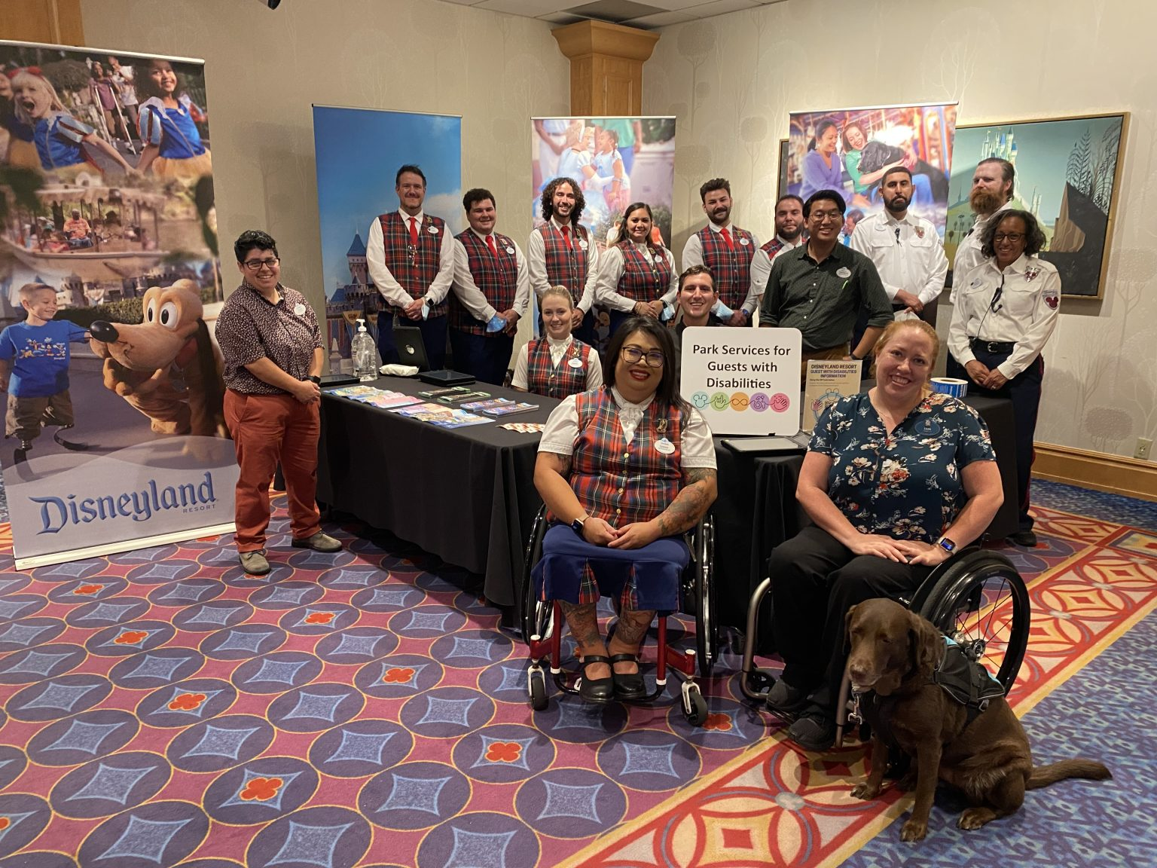
AL ASPE 2025
Thinking Like an Imagineer
Key Qualities:
Leading with Accessibility in Mind at Disneyland Park | July 8, 2022
Disney Imagineers design experiences that are both inclusive and impactful. At Disneyland, accessibility efforts shaped by lived experience show how thoughtful design can create belonging. We can bring that same care to our work—supported by tools like AI.
Imagination
Empathy
Innovation
Storytelling
Designs with people in mind
Uses tools to tell stories
Inspires creative problem solving

Slide 6


AL ASPE 2025
Simple Ways to Start Using AI
AI isn’t here to replace you—it’s here to support you. These tools can make communication clearer, generate creative strategies, and reduce time spent on routine tasks. At each step of your workflow, AI can help you focus more energy on human connection and meaningful outcomes.
Workflow Roadmap
Clarify your message
Brainstorm new ideas
Personalize support
Reflect with session notes
Streamline your planning
Draft quick follow-ups

Slide 7


AL ASPE 2025
Common Challenges and Roadblocks
Explaining complex ideas
Brainstorming when stuck
Before we explore prompts together, let’s name a few common challenges. Whether it’s finding time, communicating clearly, or coming up with new ideas, these roadblocks are exactly where AI can help. Let’s see what support you’d want from a sidekick.
Too little time
to prepare
Meeting unique client needs

Slide 8


AL ASPE 2025
Prompt Lab: Imagine Your Sidekick in Action
Let’s explore how AI can assist with real challenges in your daily work—especially around communication, planning, and creative problem-solving—and discover ways it can be used as an empowering tool.
Instructions:
Step 1: Visit each board and add one sticky note per challenge using real examples.
Step 2: Return to your table, review notes, and pick one that reflects your biggest need, time-saving potential, or an overlooked issue.
Reminder: Aim for thoughtful examples and clear rationale. The goal is to start imagining how AI might support your everyday workflow.

Slide 9

AL ASPE 2025
Let’s Ask the Sidekick
People Creating Big Impact
We’ll now test a few of the challenges you shared using a live AI tool. Together, we’ll explore how AI responds, what it gets right, and where it might miss the mark. This is about experimenting—not perfection.
Exploring AI’s Real-Time Responses
As we review each response, reflect on how this might fit into your work. Would it save time? Spark new ideas? Feel incomplete? Your insights are key—AI isn’t the expert here, you are.

Slide 10

Conclusion + Reflection
What’s one idea you’d like to try?
Your Next Step with AI
You don’t need to be an expert to start using AI. Small steps—like testing a prompt or simplifying a task—can make a real difference. Let curiosity guide you, and use what works to lighten your load and better support those you serve.
AL ASPE 2025

Slide 11

AL ASPE 2025
Thank You For Your Attention
Start Small. Think Big. Lead with Curiosity.
Q&A – Let’s Talk Possibilities
LinkedIn
in/cadambarnes
Email
abarnes@southalabama.edu

